Slide 1
Services in a Converged WAN
Accessing the WAN – Chapter 1

Slide 2
Objectives
Describe how the Cisco Enterprise Composite Model (ECNM) provides integrated services over an Enterprise network.
Describe the key WAN technology concepts.
Identify the appropriate WAN technologies to use when matching ECNM best practices with typical enterprise requirements for WAN communications.

Slide 3
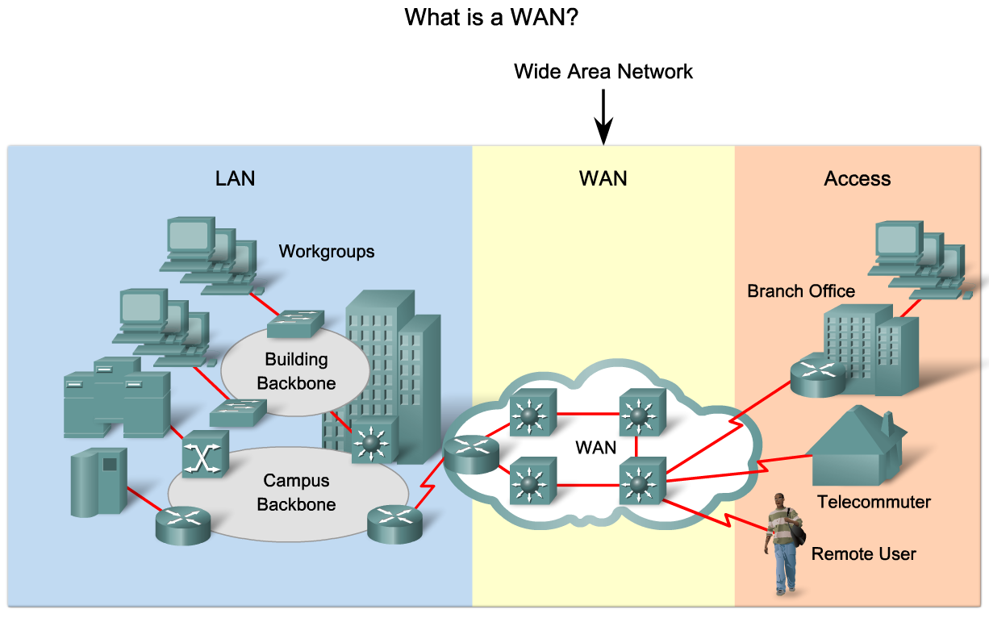
Describe How ECNM Provides Integrated Services over an Enterprise Network
Explain the purpose and function of WANs

Slide 4
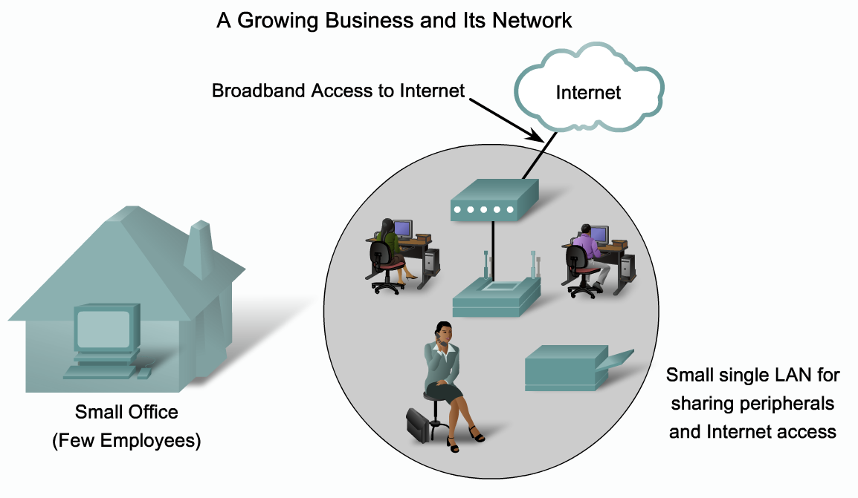
Describe How ECNM Provides Integrated Services over an Enterprise Network
Describe the stages of business growth, the corresponding business requirements for services and how those requirements are reflected in the Enterprise’s changing network topology

Slide 5
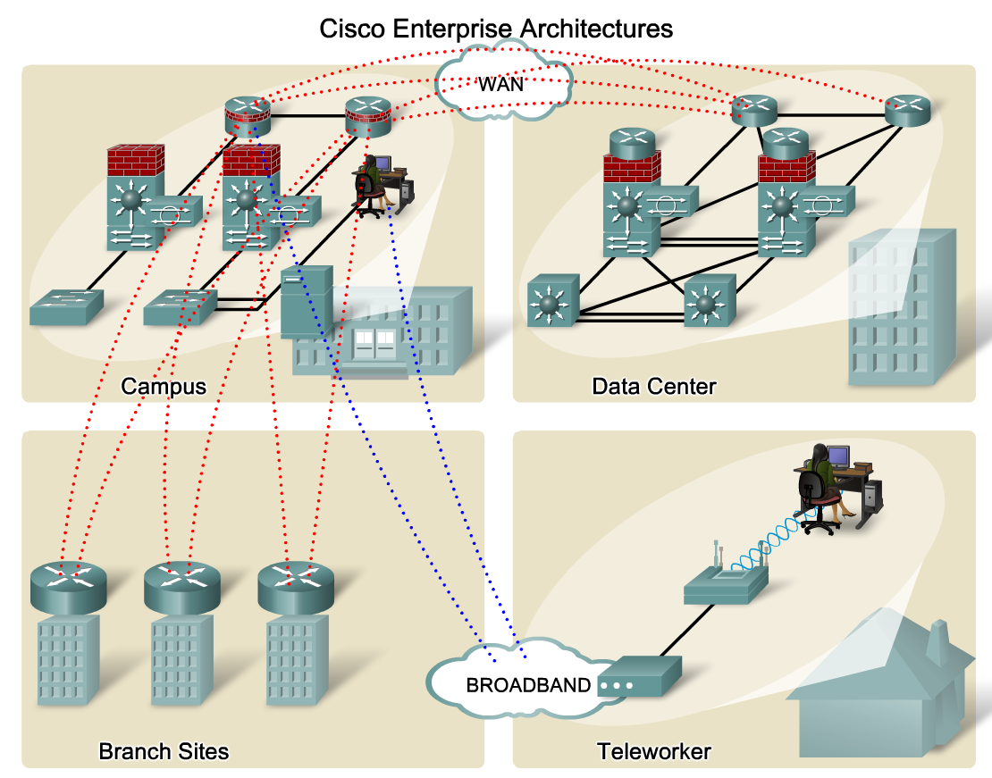
Describe How ECNM Provides Integrated Services over an Enterprise Network
Describe the problems with the Hierarchical Design Model that Cisco's Enterprise Composite Model has been designed to address

Slide 6
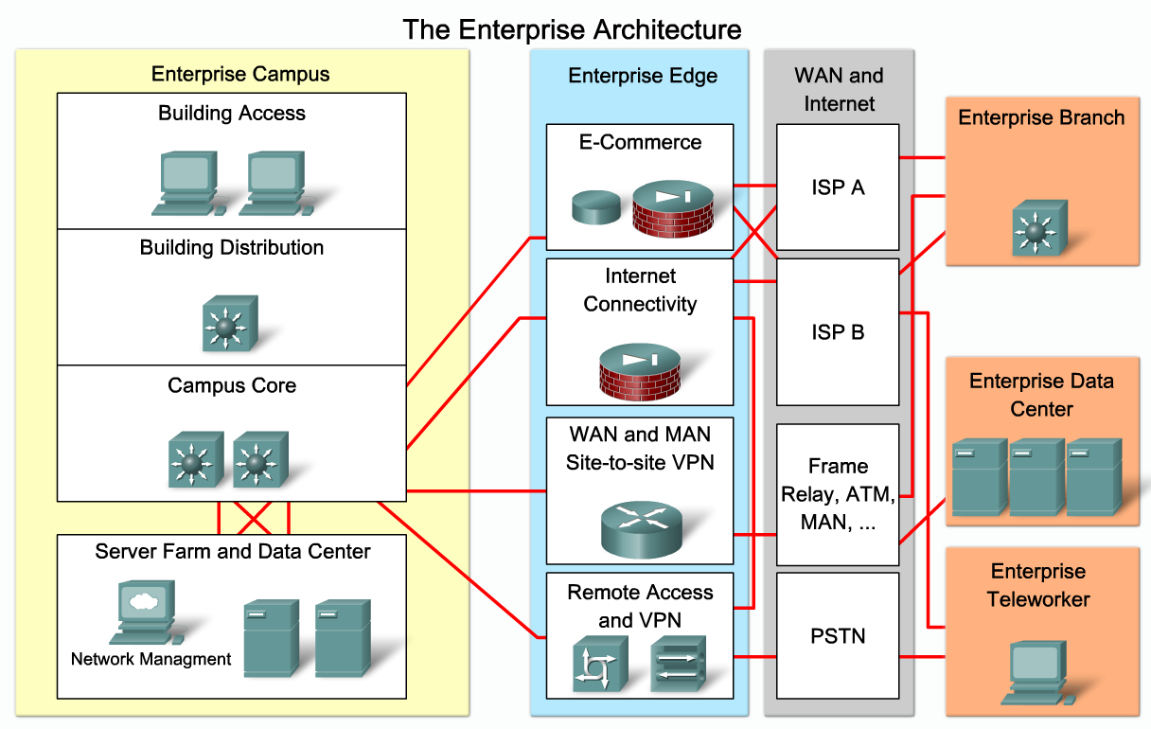
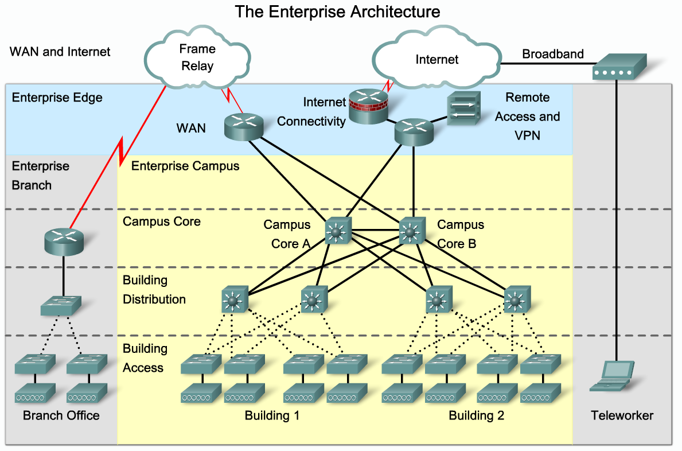
Describe How ECNM Provides Integrated Services over an Enterprise Network
Explain the purpose of Cisco Enterprise Architectures

Slide 7
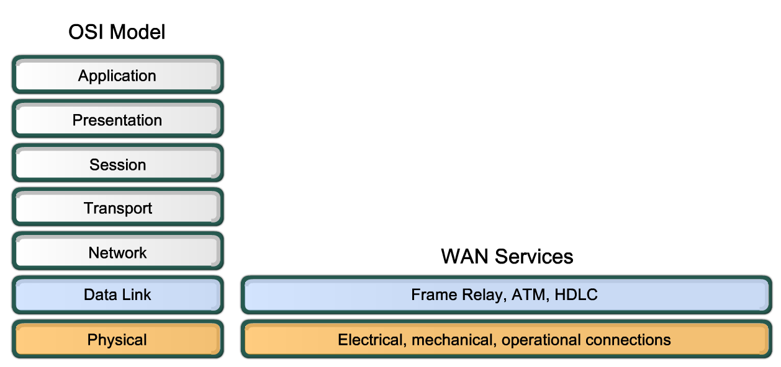
Describe the Key WAN Technology Concepts
Describe WAN functions in terms of the OSI Reference Model

Slide 8
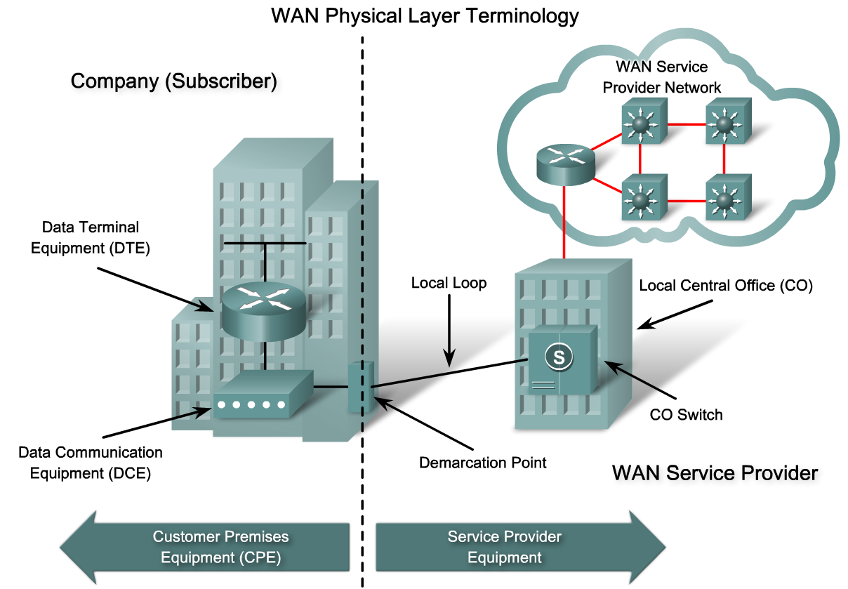
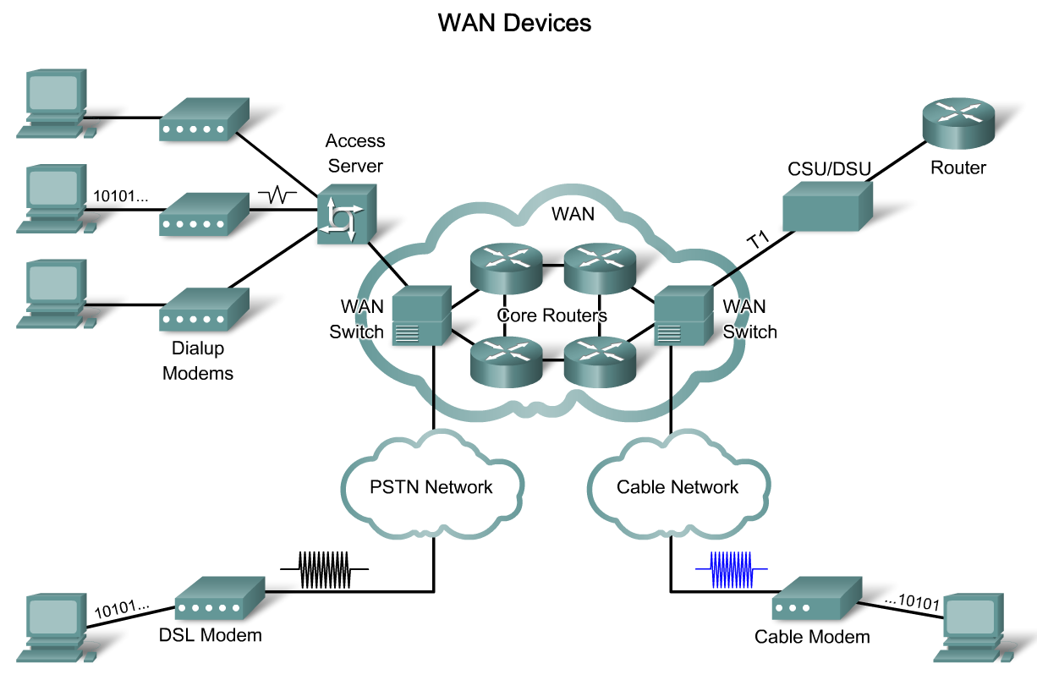
Describe the Key WAN Technology Concepts
Describe the key WAN physical layer concepts for network and Internet communications

Slide 9
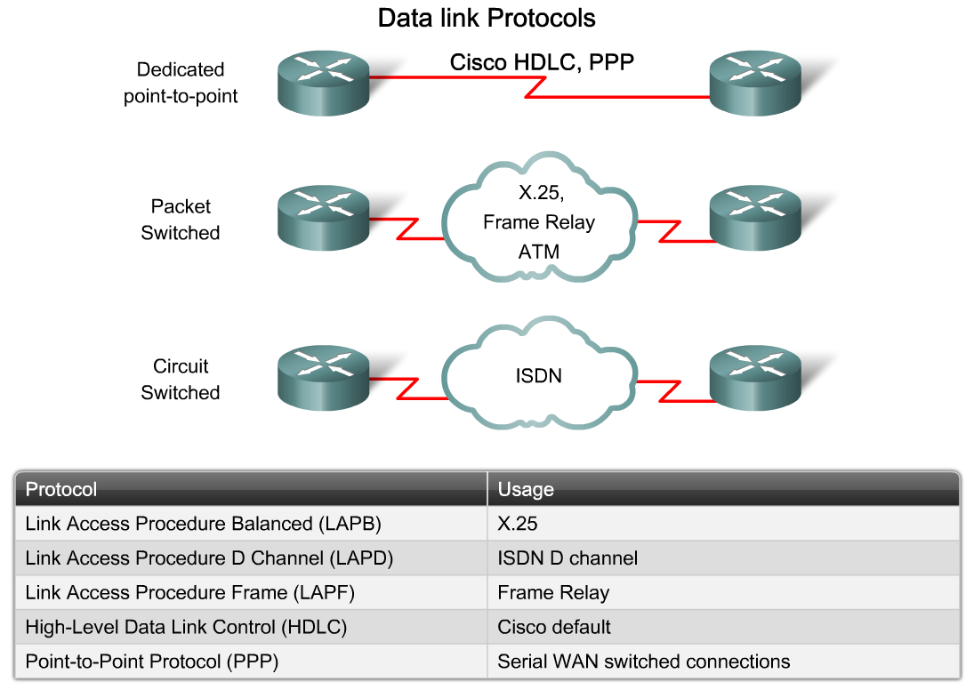
Describe the Key WAN Technology Concepts
Describe the key WAN data link layer protocols used in today’s Enterprise WAN networks

Slide 10
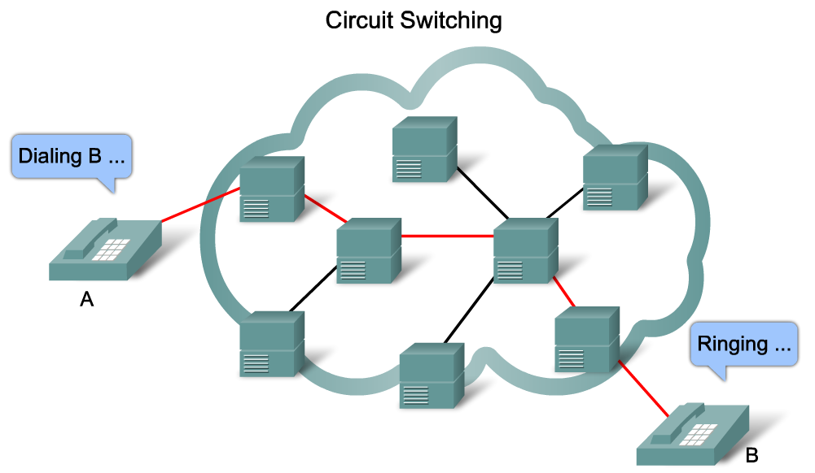
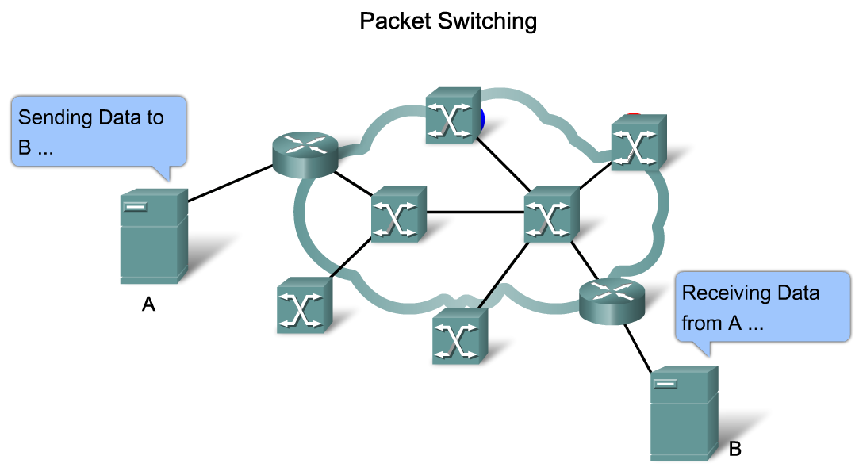
Describe the Key WAN Technology Concepts
Describe the switching technologies used for WANs in an Enterprise setting

Slide 11
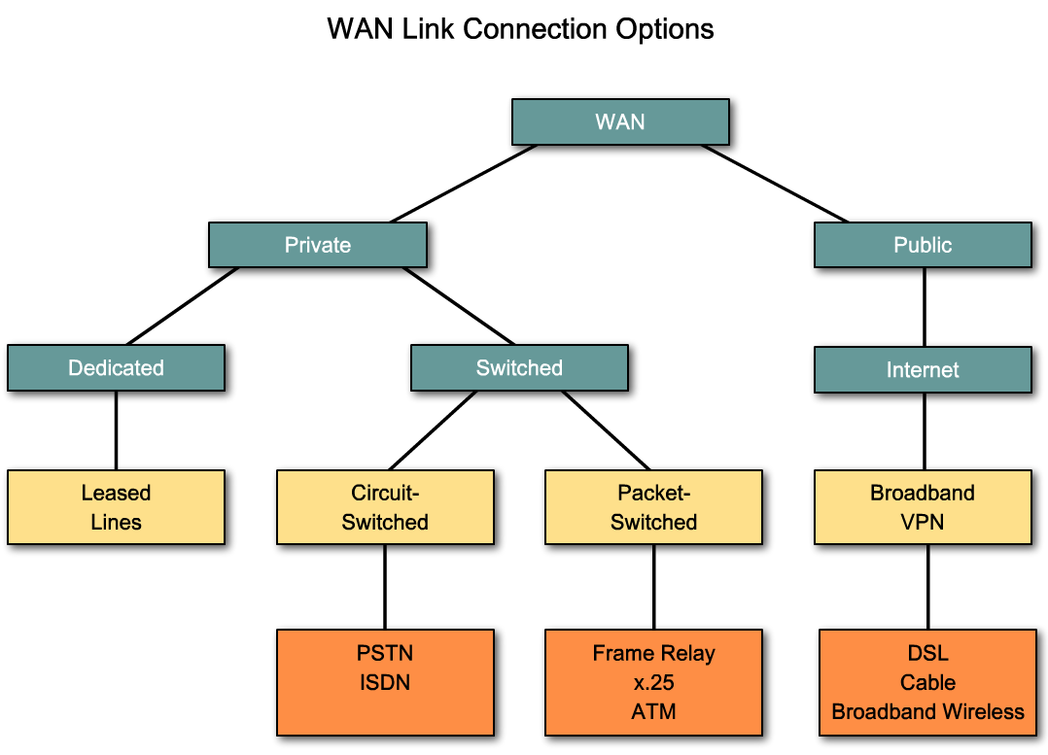
Select the Appropriate WAN Technology to meet ECNM Requirements
List the various options for connecting subscribers to the WAN

Slide 12
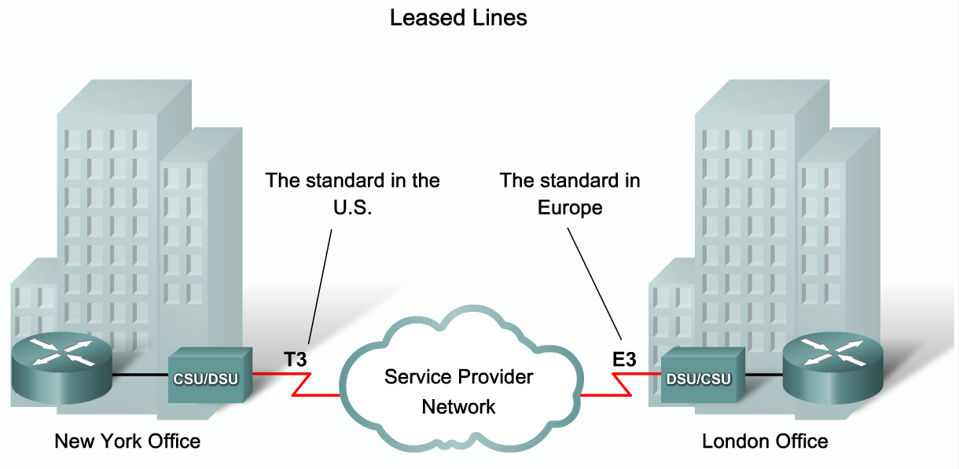
Select the Appropriate WAN Technology to meet ECNM Requirements
Describe how Enterprises use leased line services to provide a WAN connection

Slide 13
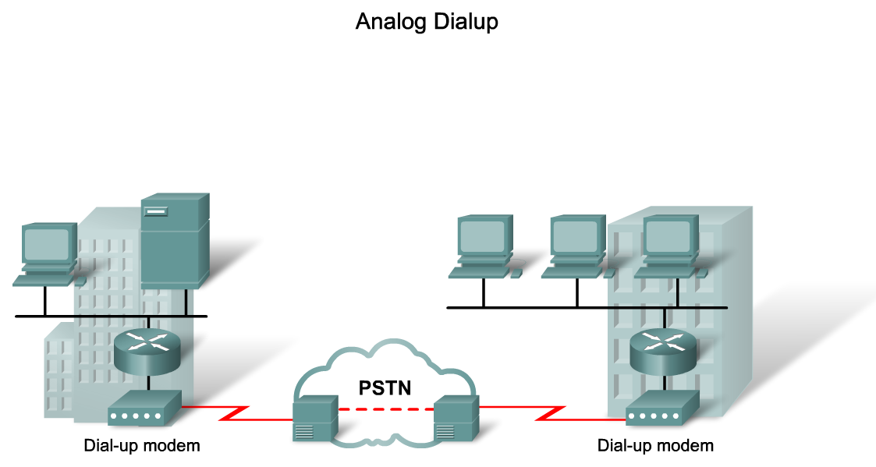
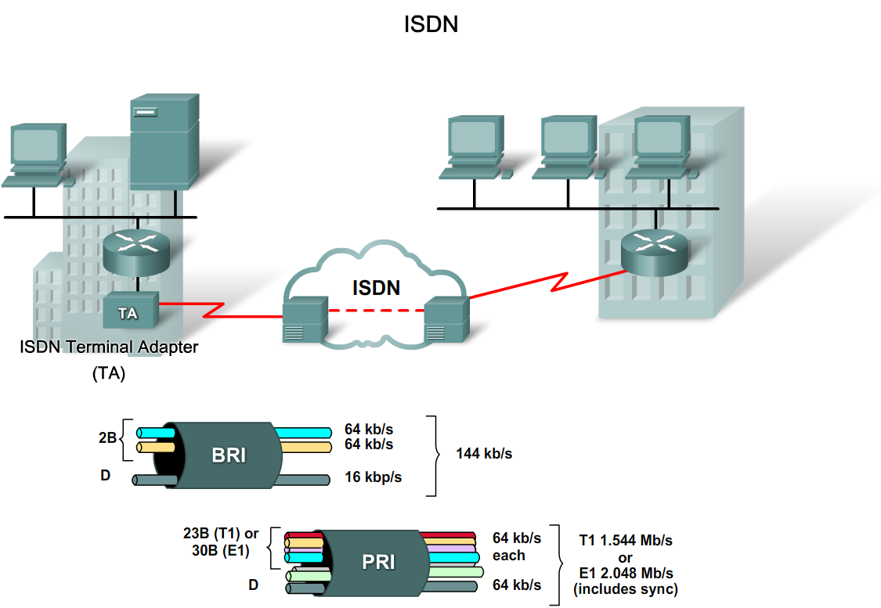
Select the Appropriate WAN Technology to meet ECNM Requirements
Describe the circuit switching options available to provide a WAN connection

Slide 14
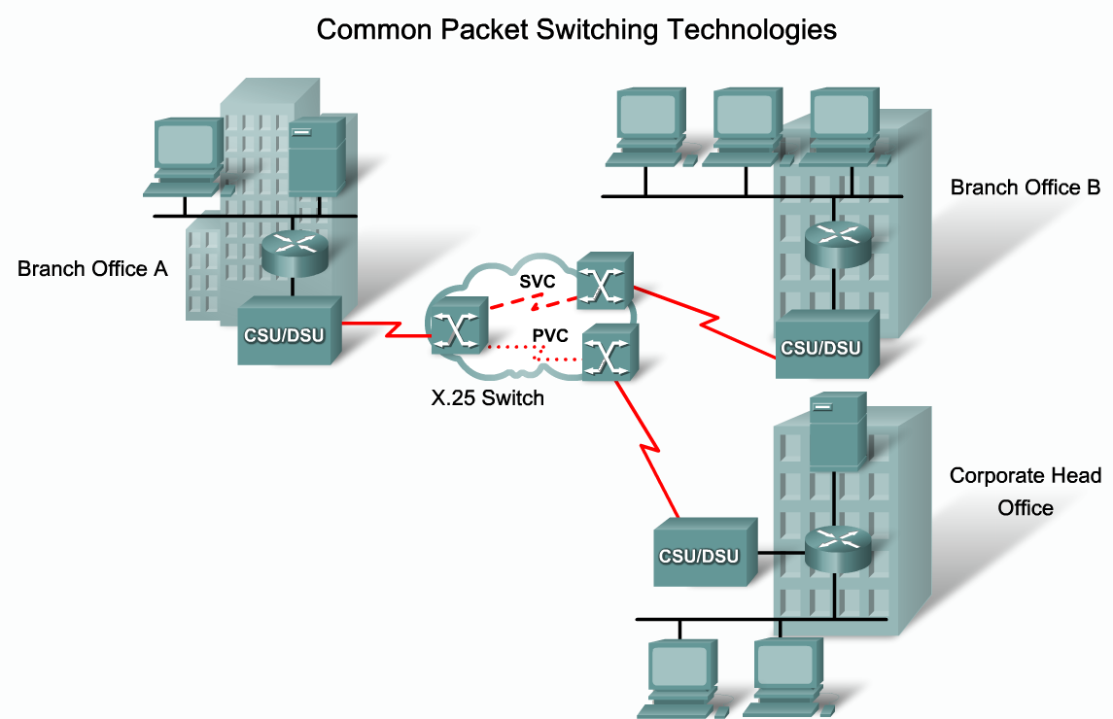
Select the Appropriate WAN Technology to meet ECNM Requirements
Describe the packet switching options available to provide a WAN connection

Slide 15
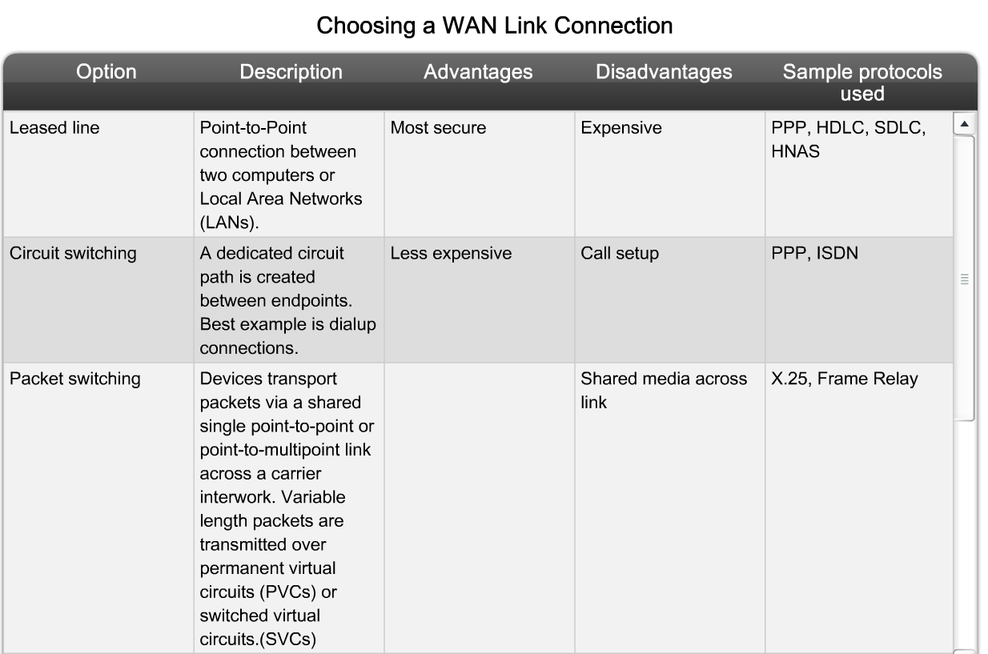
Select the Appropriate WAN Technology to meet ECNM Requirements
List factors to consider when selecting a WAN connection

Slide 16
Summary
A WAN is defined as
  A data communications network that operates beyond the geographic scope of a LAN
WAN primarily operate on layer 1 & 2 of the OSI model
WAN technologies include
  Leased line
  ISDN
  Frame relay
  X.25
  ATM

Slide 17
Summary
Cisco Enterprise Architecture
  This is an expansion of the hierarchical model that further divides the enterprise network into
    Physical areas
    Logical areas
    Functional areas
Selecting the appropriate WAN technology requires considering some of the following:
  WAN’s purpose
  Geographic scope of WAN
  Traffic requirements
  If WAN uses a public or private infrastructure

